Slide 1
The Entry
Matthew 21:1-11New International Version (NIV)
Jesus Comes to Jerusalem as King
As they approached Jerusalem and came to Bethphage on the Mount of Olives, Jesus sent two disciples, ² saying to them, “Go to the village ahead of you, and at once you will find a donkey tied there, with her colt by her. Untie them and bring them to me. ³ If anyone says anything to you, say that the Lord needs them, and he will send them right away.”

Slide 2
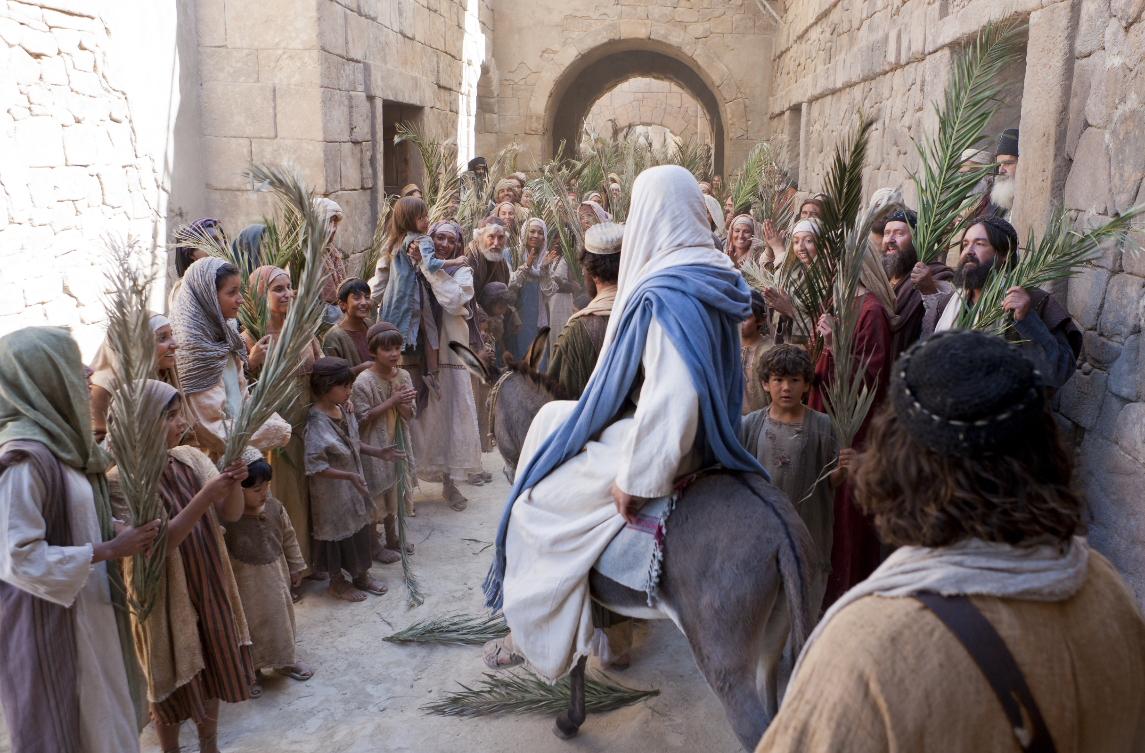

Slide 3
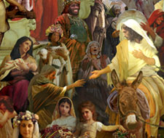
This took place to fulfill what was spoken through the prophet:
⁵ “Say to Daughter Zion, ‘See, your king comes to you, gentle and riding on a donkey, and on a colt, the foal of a donkey.’
⁶ The disciples went and did as Jesus had instructed them. ⁷ They brought the donkey and the colt and placed their cloaks on them for Jesus to sit on. ⁸ A very large crowd spread their cloaks on the road, while others cut branches from the trees and spread them on the road. ⁹ The crowds that went ahead of him and those that followed shouted,
“Hosanna^{[b]} to the Son of David!”

Slide 4
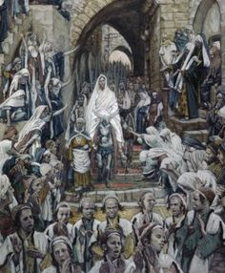
“Blessed is he who comes in the name of the Lord!”
“Hosanna in the highest heaven!”
¹⁰ When Jesus entered Jerusalem, the whole city was stirred and asked, “Who is this?”
¹¹ The crowds answered, “This is Jesus, the prophet from Nazareth in Galilee.”

Slide 5
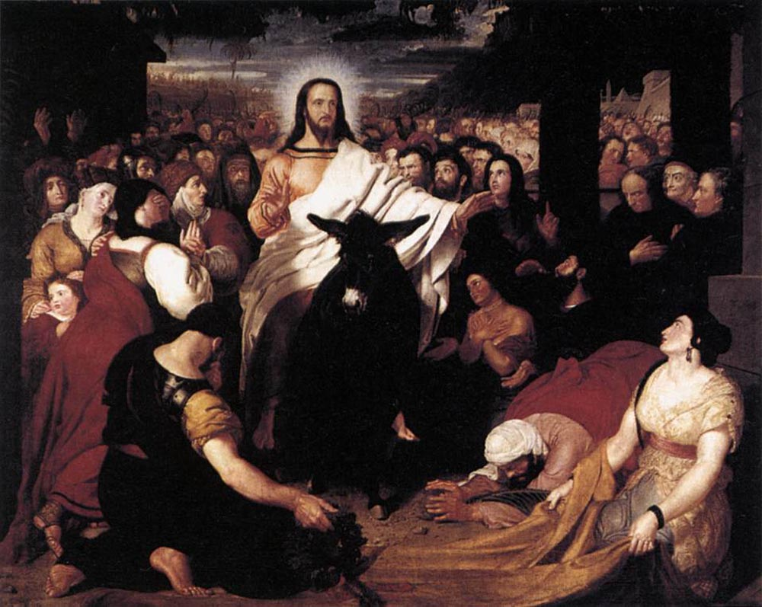
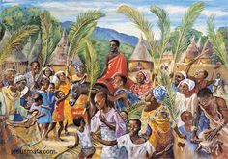

Slide 6
The First Betryal
Matthew 26:14-16
¹⁴ Then one of the Twelve—the one called Judas Iscariot—went to the chief priests ¹⁵ and asked, “What are you willing to give me if I deliver him over to you?” So they counted out for him thirty pieces of silver. ¹⁶ From then on Judas watched for an opportunity to hand him over.

Slide 7
The Supper
Matthew 26:17-23
¹⁷ On the first day of the Festival of Unleavened Bread, the disciples came to Jesus and asked, “Where do you want us to make preparations for you to eat the Passover?”
¹⁸ He replied, “Go into the city to a certain man and tell him, ‘The Teacher says: My appointed time is near. I am going to celebrate the Passover with my disciples at your house.’” ¹⁹ So the disciples did as Jesus had directed them and prepared the Passover.
²⁰ When evening came, Jesus was reclining at the table with the Twelve. ²¹ And while they were eating, he said, “Truly I tell you, one of you will betray me.”
²² They were very sad and began to say to him one after the other, “Surely you don’t mean me, Lord?”
²³ Jesus replied, “The one who has dipped his hand into the bowl with me will betray me. ²⁴ The Son of Man will go just as it is written about him. But woe to that man who betrays the Son of Man! It would be better for him if he had not been born.”

Slide 8
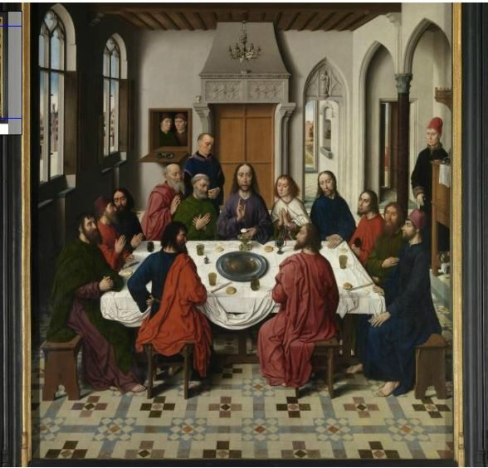
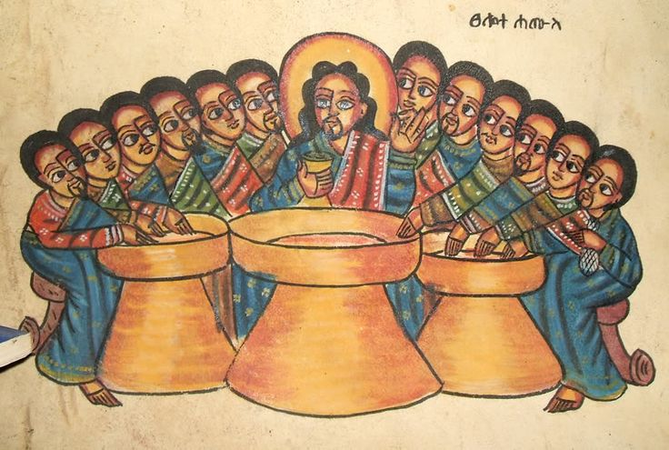

Slide 9
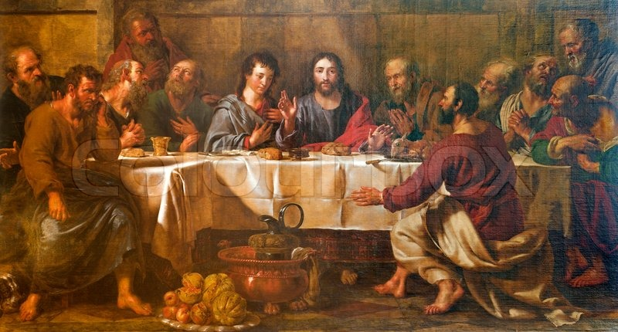

Slide 10
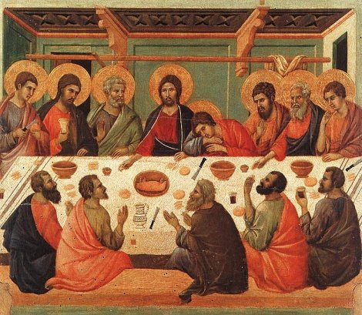
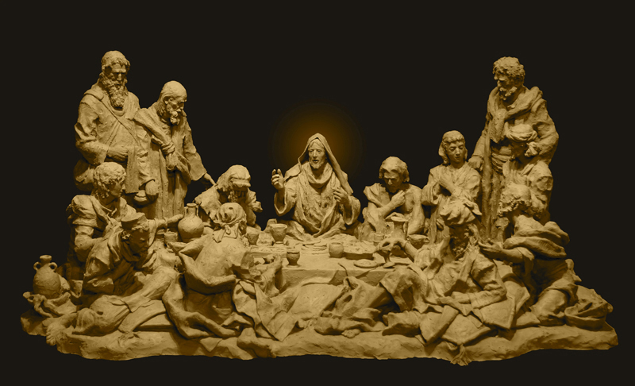
Matthew 26:25-30
²⁵ Then Judas, the one who would betray him, said, “Surely you don’t mean me, Rabbi?”
Jesus answered, “You have said so.”
²⁶ While they were eating, Jesus took bread, and when he had given thanks, he broke it and gave it to his disciples, saying, “Take and eat; this is my body.”
²⁷ Then he took a cup, and when he had given thanks, he gave it to them, saying, “Drink from it, all of you. ²⁸ This is my blood of the^{[b]} covenant, which is poured out for many for the forgiveness of sins. ²⁹ I tell you, I will not drink from this fruit of the vine from now on until that day when I drink it new with you in my Father’s kingdom.”
³⁰ When they had sung a hymn, they went out to the Mount of Olives.

Slide 11
The Garden
³⁶ Then Jesus went with his disciples to a place called Gethsemane, and he said to them, “Sit here while I go over there and pray.” ³⁷ He took Peter and the two sons of Zebedee along with him, and he began to be sorrowful and troubled. ³⁸ Then he said to them, “My soul is overwhelmed with sorrow to the point of death. Stay here and keep watch with me.”
³⁹ Going a little farther, he fell with his face to the ground and prayed, “My Father, if it is possible, may this cup be taken from me. Yet not as I will, but as you will.”
⁴⁰ Then he returned to his disciples and found them sleeping. “Couldn’t you men keep watch with me for one hour?” he asked Peter. ⁴¹ “Watch and pray so that you will not fall into temptation. The spirit is willing, but the flesh is weak.”

Slide 12
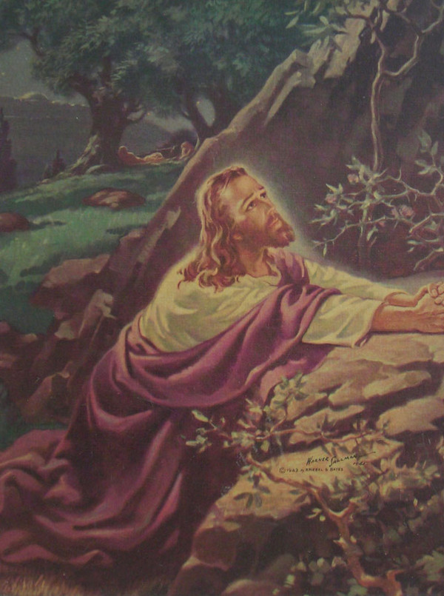
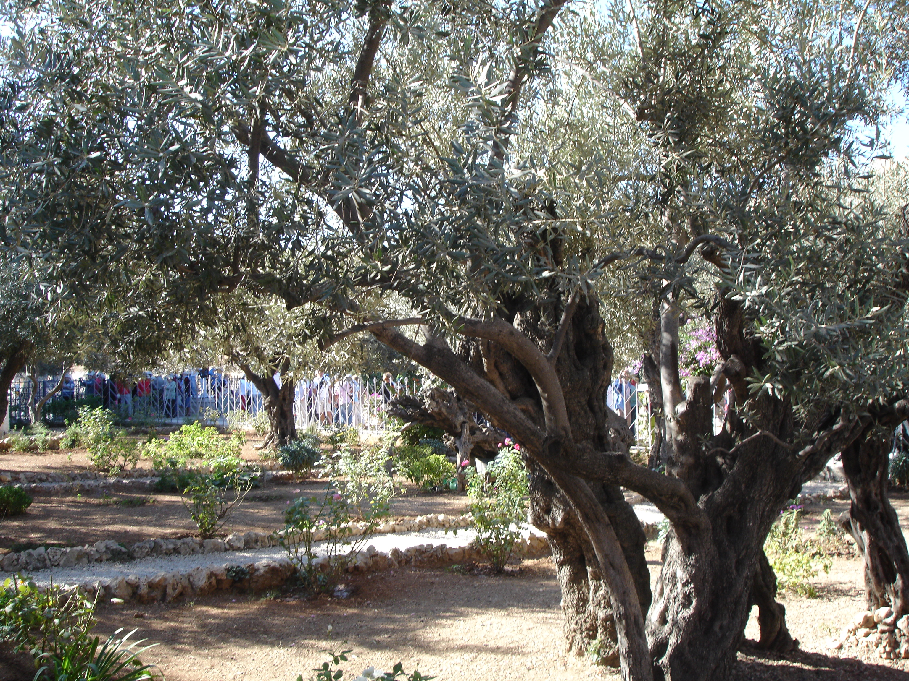
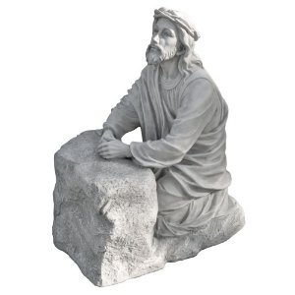
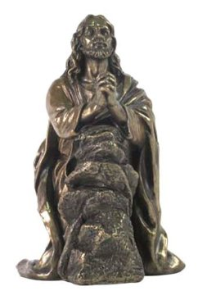
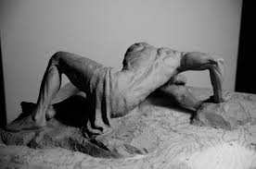

Slide 13
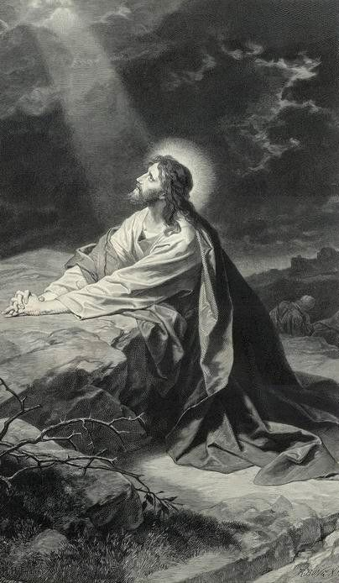
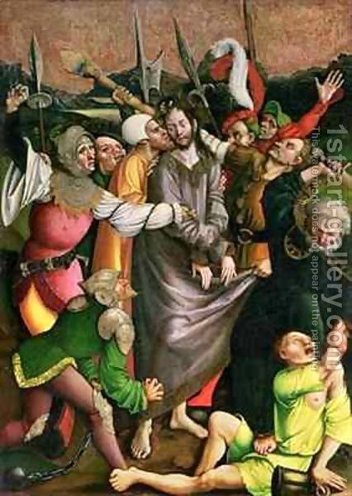
⁴² He went away a second time and prayed, “My Father, if it is not possible for this cup to be taken away unless I drink it, may your will be done.”
⁴³ When he came back, he again found them sleeping, because their eyes were heavy. ⁴⁴ So he left them and went away once more and prayed the third time, saying the same thing.
⁴⁵ Then he returned to the disciples and said to them, “Are you still sleeping and resting? Look, the hour has come, and the Son of Man is delivered into the hands of sinners. ⁴⁶ Rise! Let us go! Here comes my betrayer!”

Slide 14
The Arrest
Matthew 26:47-51
⁴⁷ While he was still speaking, Judas, one of the Twelve, arrived. With him was a large crowd armed with swords and clubs, sent from the chief priests and the elders of the people. ⁴⁸ Now the betrayer had arranged a signal with them: “The one I kiss is the man; arrest him.” ⁴⁹ Going at once to Jesus, Judas said, “Greetings, Rabbi!” and kissed him.
⁵⁰ Jesus replied, “Do what you came for, friend.”
Then the men stepped forward, seized Jesus and arrested him. ⁵¹ With that, one of Jesus’ companions reached for his sword, drew it out and struck the servant of the high priest, cutting off his ear.

Slide 15
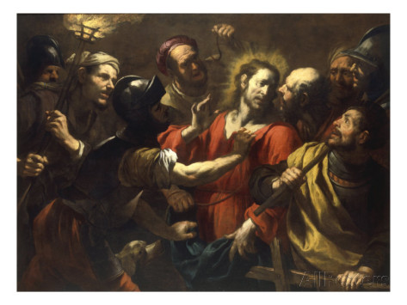

Slide 16
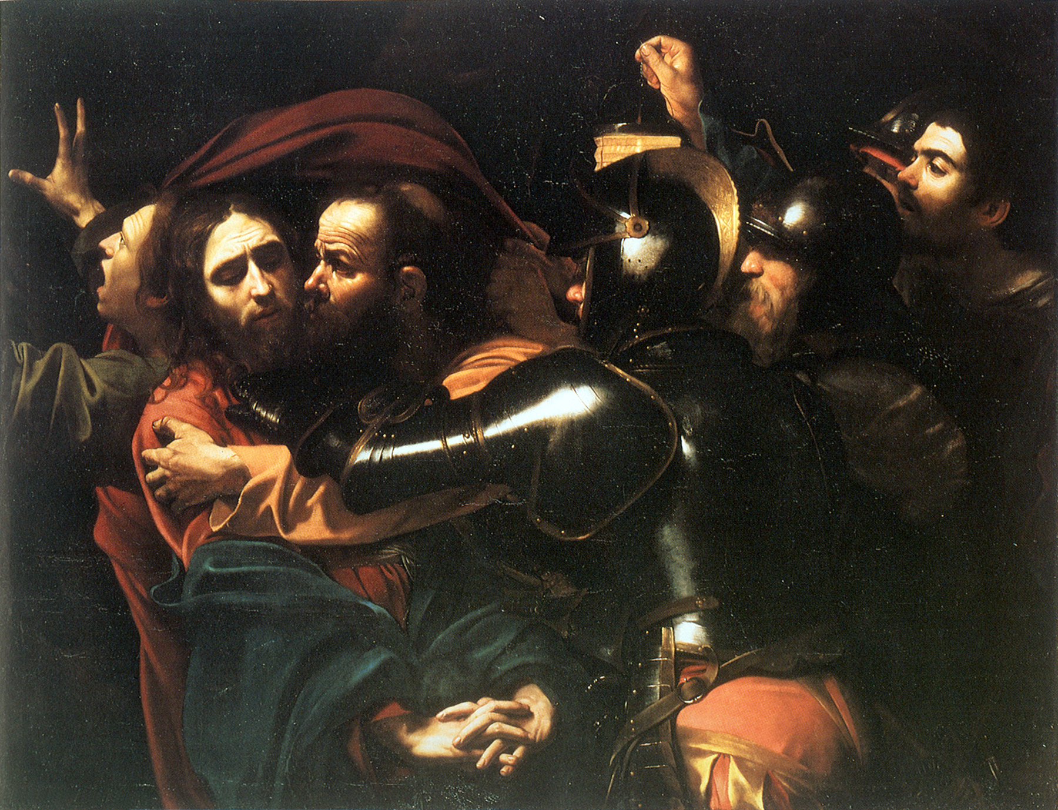

Slide 17
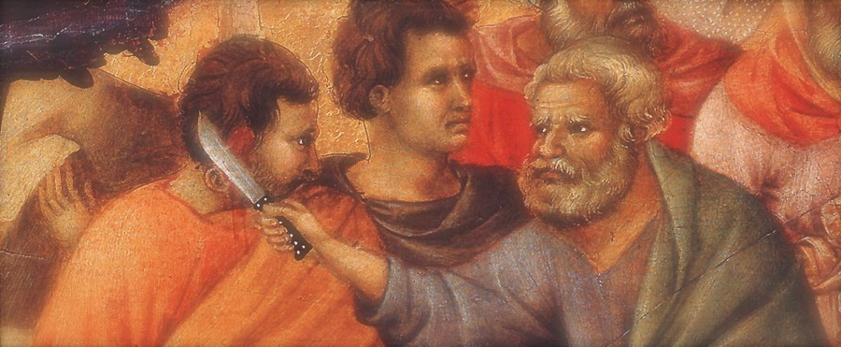
⁵² “Put your sword back in its place,” Jesus said to him, “for all who draw the sword will die by the sword. ⁵³ Do you think I cannot call on my Father, and he will at once put at my disposal more than twelve legions of angels? ⁵⁴ But how then would the Scriptures be fulfilled that say it must happen in this way?”
⁵⁵ In that hour Jesus said to the crowd, “Am I leading a rebellion, that you have come out with swords and clubs to capture me? Every day I sat in the temple courts teaching, and you did not arrest me. ⁵⁶ But this has all taken place that the writings of the prophets might be fulfilled.” Then all the disciples deserted him and fled.

Slide 18
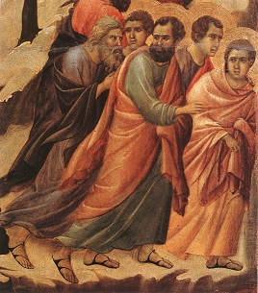

Slide 19
The Sanhedrin
Jesus Before the Sanhedrin
⁵⁷ Those who had arrested Jesus took him to Caiaphas the high priest, where the teachers of the law and the elders had assembled. ⁵⁸ But Peter followed him at a distance, right up to the courtyard of the high priest. He entered and sat down with the guards to see the outcome.
⁵⁹ The chief priests and the whole Sanhedrin were looking for false evidence against Jesus so that they could put him to death. ⁶⁰ But they did not find any, though many false witnesses came forward.
Finally two came forward ⁶¹ and declared, “This fellow said, ‘I am able to destroy the temple of God and rebuild it in three days.’”
⁶² Then the high priest stood up and said to Jesus, “Are you not going to answer? What is this testimony that these men are bringing against you?” ⁶³ But Jesus remained silent.
The high priest said to him, “I charge you under oath by the living God: Tell us if you are the Messiah, the Son of God.”
⁶⁴ “You have said so,” Jesus replied. “But I say to all of you: From now on you will see the Son of Man sitting at the right hand of the Mighty One and coming on the clouds of heaven.”
⁶⁵ Then the high priest tore his clothes and said, “He has spoken blasphemy! Why do we need any more witnesses? Look, now you have heard the blasphemy. ⁶⁶ What do you think?”
“He is worthy of death,” they answered.
⁶⁷ Then they spit in his face and struck him with their fists. Others slapped him ⁶⁸ and said, “Prophesy to us, Messiah. Who hit you?”

Slide 20
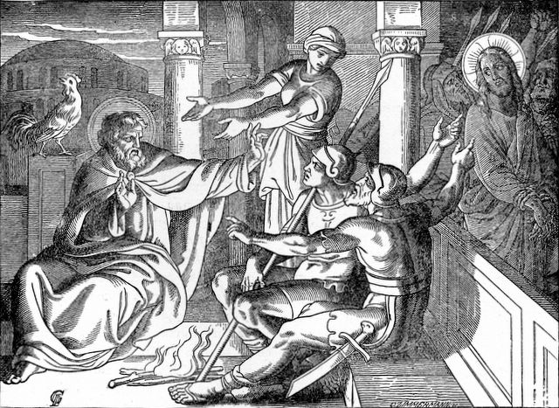
The Denial
Matthew 26:69-72
⁶⁹ Now Peter was sitting out in the courtyard, and a servant girl came to him. “You also were with Jesus of Galilee,” she said.
⁷⁰ But he denied it before them all. “I don’t know what you’re talking about,” he said.
⁷¹ Then he went out to the gateway, where another servant girl saw him and said to the people there, “This fellow was with Jesus of Nazareth.”
⁷² He denied it again, with an oath: “I don’t know the man!”

Slide 21
⁷³ After a little while, those standing there went up to Peter and said, “Surely you are one of them; your accent gives you away.”
⁷⁴ Then he began to call down curses, and he swore to them, “I don’t know the man!”
Immediately a rooster crowed. ⁷⁵ Then Peter remembered the word Jesus had spoken: “Before the rooster crows, you will disown me three times.” And he went outside and wept bitterly.

Slide 22
The Trial
Matthew 27:11-14
Jesus stood before the governor, and the governor asked him, “Are you the king of the Jews?”
“You have said so,” Jesus replied.
¹² When he was accused by the chief priests and the elders, he gave no answer. ¹³ Then Pilate asked him, “Don’t you hear the testimony they are bringing against you?” ¹⁴ But Jesus made no reply, not even to a single charge—to the great amazement of the governor.

Slide 23
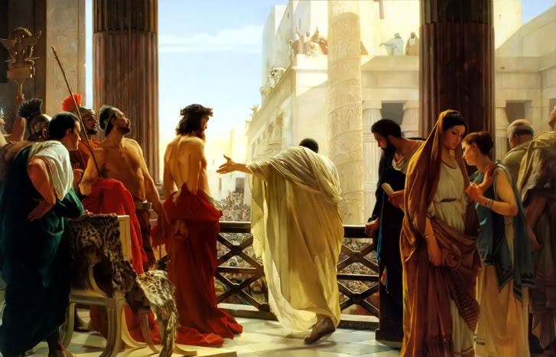
Matthew 27:15-18
¹⁵ Now it was the governor’s custom at the festival to release a prisoner chosen by the crowd. ¹⁶ At that time they had a well-known prisoner whose name was Jesus Barabbas. ¹⁷ So when the crowd had gathered, Pilate asked them, “Which one do you want me to release to you: Jesus Barabbas, or Jesus who is called the Messiah?” ¹⁸ For he knew it was out of self-interest that they had handed Jesus over to him.

Slide 24
The Sentence
Matthew 27:19-23
While Pilate was sitting on the judge’s seat, his wife sent him this message: “Don’t have anything to do with that innocent man, for I have suffered a great deal today in a dream because of him.”
²⁰ But the chief priests and the elders persuaded the crowd to ask for Barabbas and to have Jesus executed.
²¹ “Which of the two do you want me to release to you?” asked the governor.
“Barabbas,” they answered.
²² “What shall I do, then, with Jesus who is called the Messiah?” Pilate asked.
They all answered, “Crucify him!”
²³ “Why? What crime has he committed?” asked Pilate.
But they shouted all the louder, “Crucify him!”

Slide 25
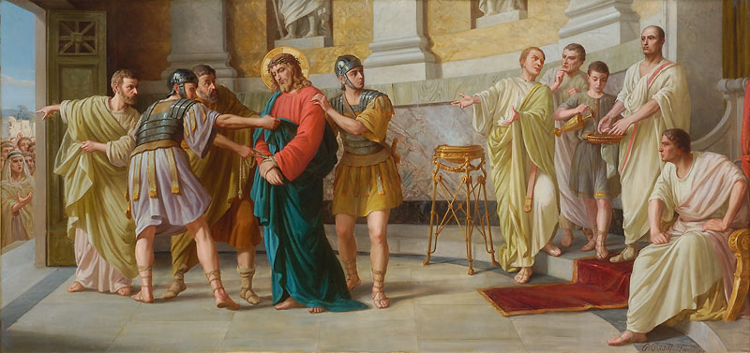
²³ “Why? What crime has he committed?” asked Pilate.
But they shouted all the louder, “Crucify him!”
²⁴ When Pilate saw that he was getting nowhere, but that instead an uproar was starting, he took water and washed his hands in front of the crowd. “I am innocent of this man’s blood,” he said. “It is your responsibility!”
²⁵ All the people answered, “His blood is on us and on our children!”
²⁶ Then he released Barabbas to them. But he had Jesus flogged, and handed him over to be crucified

Slide 26
²⁷ Then the governor’s soldiers took Jesus into the Praetorium and gathered the whole company of soldiers around him. ²⁸ They stripped him and put a scarlet robe on him, ²⁹ and then twisted together a crown of thorns and set it on his head. They put a staff in his right hand. Then they knelt in front of him and mocked him. “Hail, king of the Jews!” they said. ³⁰ They spit on him, and took the staff and struck him on the head again and again. ³¹ After they had mocked him, they took off the robe and put his own clothes on him. Then they led him away to crucify him.

Slide 27
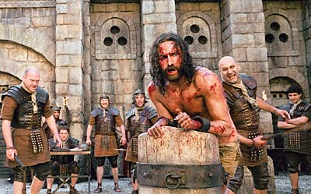
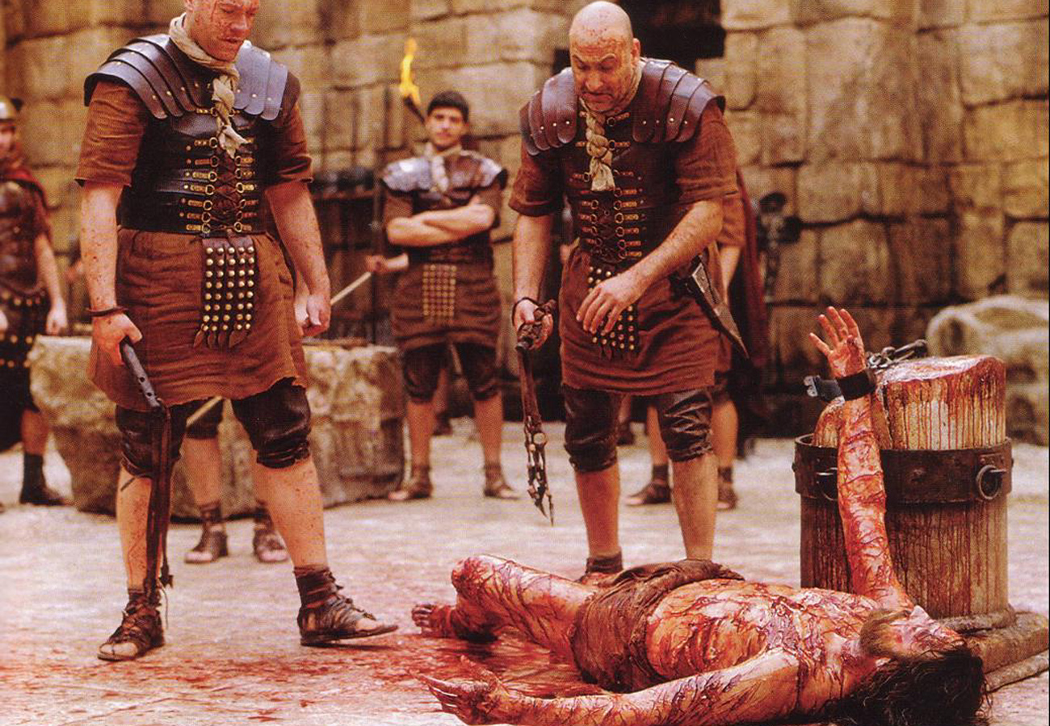

Slide 28
The Crucifixion
Matthew 27:32
As they were going out, they met a man from Cyrene, named Simon, and they forced him to carry the cross.

Slide 29
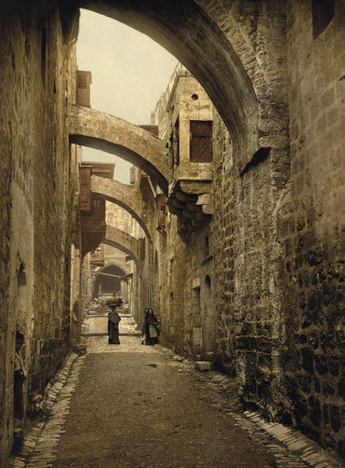
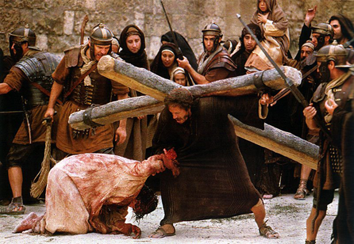

Slide 30
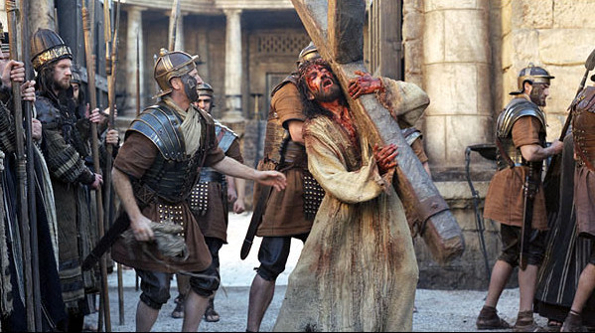

Slide 31
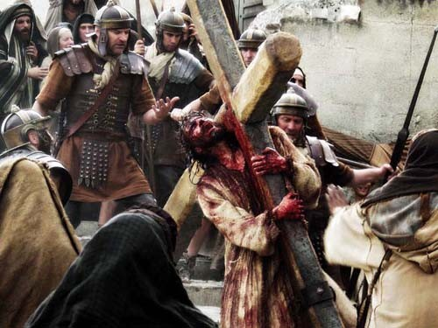
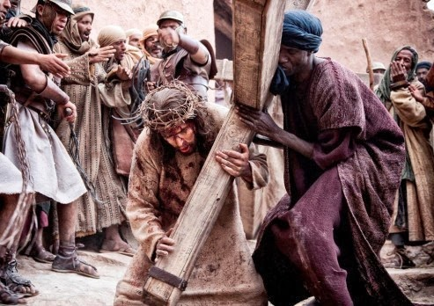

Slide 32
³³ They came to a place called Golgotha (which means “the place of the skull”). ³⁴ There they offered Jesus wine to drink, mixed with gall; but after tasting it, he refused to drink it. ³⁵ When they had crucified him, they divided up his clothes by casting lots. ³⁶ And sitting down, they kept watch over him there. ³⁷ Above his head they placed the written charge against him: this is jesus, the king of the jews.

Slide 33
³⁸ Two rebels were crucified with him, one on his right and one on his left. ³⁹ Those who passed by hurled insults at him, shaking their heads ⁴⁰ and saying, “You who are going to destroy the temple and build it in three days, save yourself! Come down from the cross, if you are the Son of God!” ⁴¹ In the same way the chief priests, the teachers of the law and the elders mocked him. ⁴² “He saved others,” they said, “but he can’t save himself! He’s the king of Israel! Let him come down now from the cross, and we will believe in him. ⁴³ He trusts in God. Let God rescue him now if he wants him, for he said, ‘I am the Son of God.’” ⁴⁴ In the same way the rebels who were crucified with him also heaped insults on him.

Slide 34
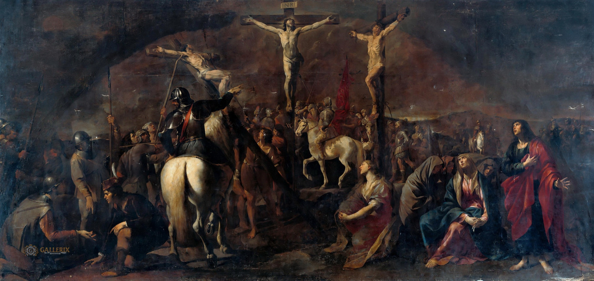

Slide 35
The Death
Matthew 27:45-50
⁴⁵ From noon until three in the afternoon darkness came over all the land. ⁴⁶ About three in the afternoon Jesus cried out in a loud voice, “Eli, Eli, lema sabachthani?” (which means “My God, my God, why have you forsaken me?”).
⁴⁷ When some of those standing there heard this, they said, “He’s calling Elijah.”
⁴⁸ Immediately one of them ran and got a sponge. He filled it with wine vinegar, put it on a staff, and offered it to Jesus to drink. ⁴⁹ The rest said, “Now leave him alone. Let’s see if Elijah comes to save him.”
⁵⁰ And when Jesus had cried out again in a loud voice, he gave up his spirit.

Slide 36
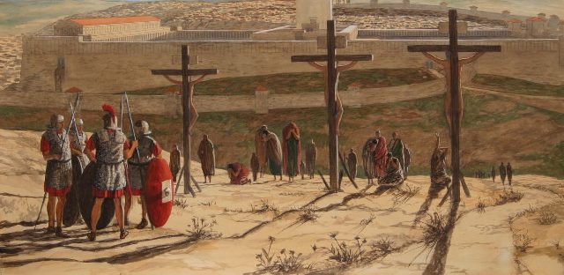

Slide 37
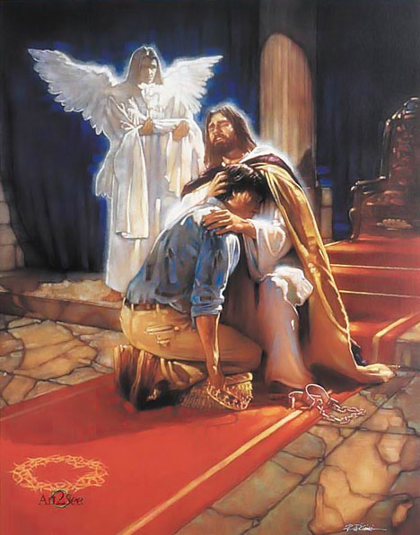

Slide 38
⁵¹ At that moment the curtain of the temple was torn in two from top to bottom. The earth shook, the rocks split ⁵² and the tombs broke open. The bodies of many holy people who had died were raised to life. ⁵³ They came out of the tombs after Jesus’ resurrection and went into the holy city and appeared to many people.
⁵⁴ When the centurion and those with him who were guarding Jesus saw the earthquake and all that had happened, they were terrified, and exclaimed, “Surely he was the Son of God!”

Slide 39
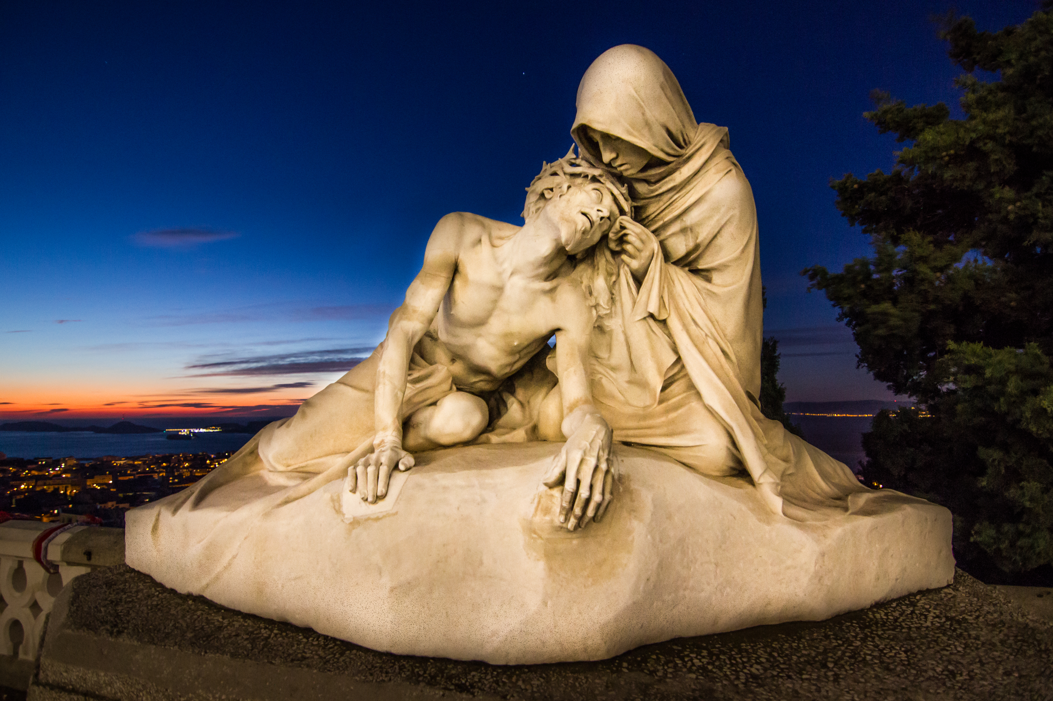
⁵⁵ Many women were there, watching from a distance. They had followed Jesus from Galilee to care for his needs. ⁵⁶ Among them were Mary Magdalene, Mary the mother of James and Joseph, and the mother of Zebedee’s sons.

Slide 40
The Burial
Matthew 27:57-61
⁵⁷ As evening approached, there came a rich man from Arimathea, named Joseph, who had himself become a disciple of Jesus. ⁵⁸ Going to Pilate, he asked for Jesus’ body, and Pilate ordered that it be given to him. ⁵⁹ Joseph took the body, wrapped it in a clean linen cloth, ⁶⁰ and placed it in his own new tomb that he had cut out of the rock. He rolled a big stone in front of the entrance to the tomb and went away. ⁶¹ Mary Magdalene and the other Mary were sitting there opposite the tomb.

Slide 41
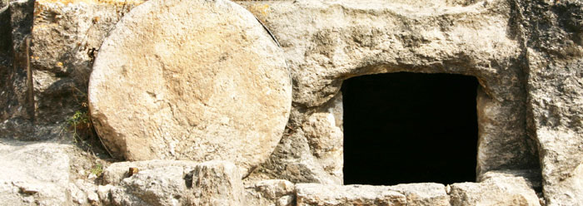

Slide 42
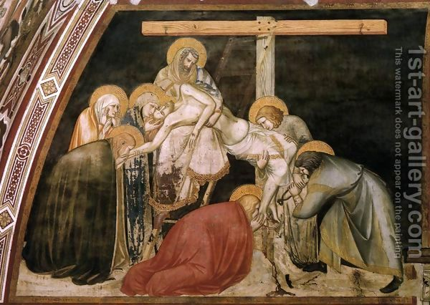

Slide 43
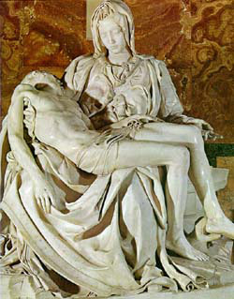
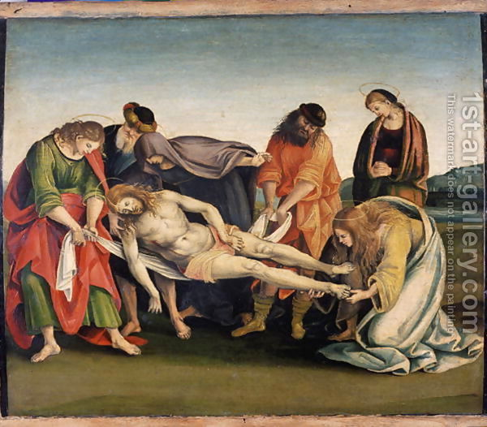

Slide 44
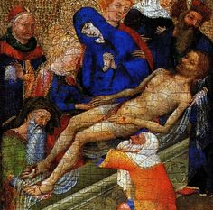
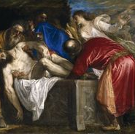

Slide 45
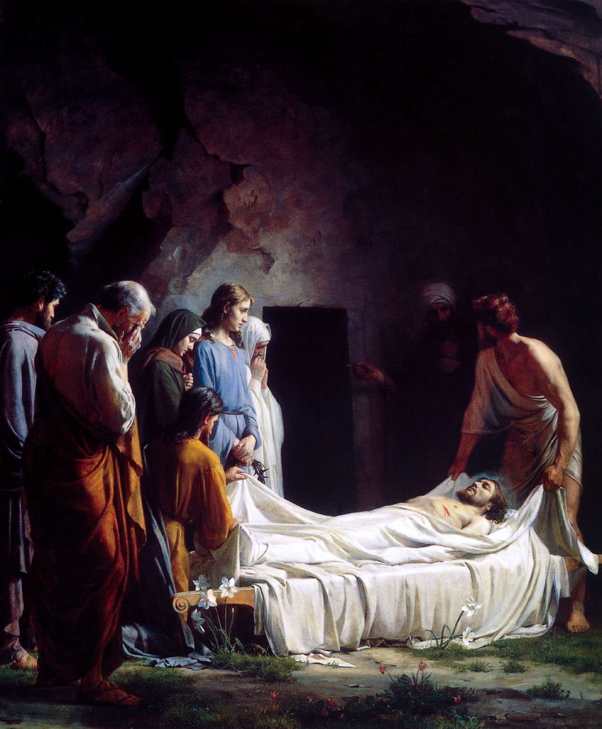

Slide 46
The Tomb
⁶² The next day, the one after Preparation Day, the chief priests and the Pharisees went to Pilate. ⁶³ “Sir,” they said, “we remember that while he was still alive that deceiver said, ‘After three days I will rise again.’ ⁶⁴ So give the order for the tomb to be made secure until the third day. Otherwise, his disciples may come and steal the body and tell the people that he has been raised from the dead. This last deception will be worse than the first.”
⁶⁵ “Take a guard,” Pilate answered. “Go, make the tomb as secure as you know how.” ⁶⁶ So they went and made the tomb secure by putting a seal on the stone and posting the guard.

Slide 47
The Resurrection
John 20
20 Early on the first day of the week, while it was still dark, Mary Magdalene went to the tomb and saw that the stone had been removed from the entrance. ² So she came running to Simon Peter and the other disciple, the one Jesus loved, and said, “They have taken the Lord out of the tomb, and we don’t know where they have put him!”

Slide 48
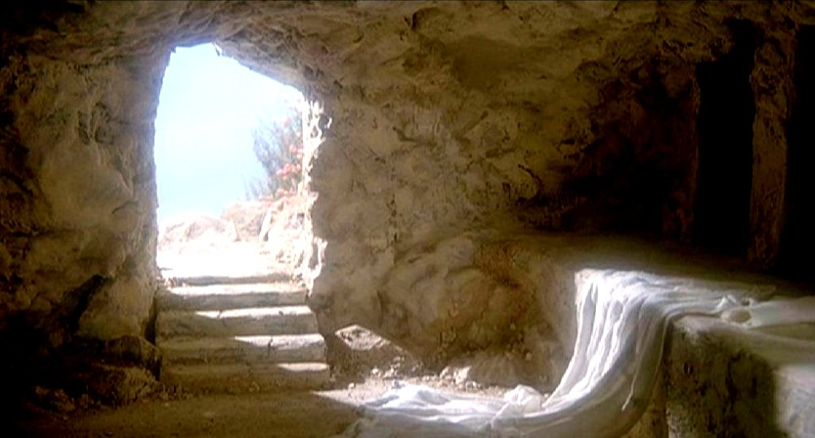

Slide 49
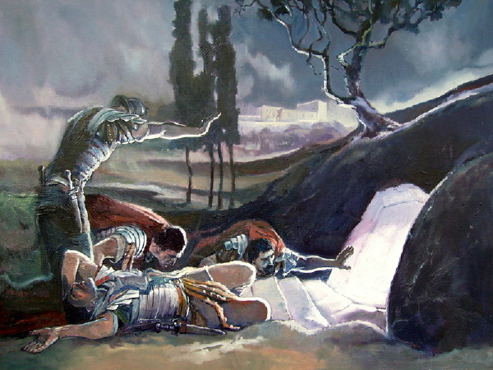

Slide 50
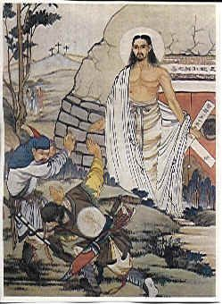

Slide 51
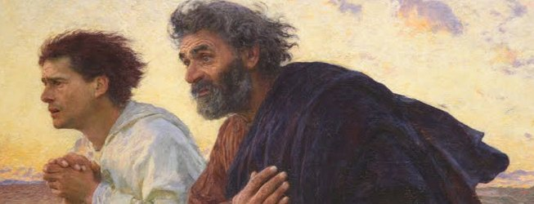
³ So Peter and the other disciple started for the tomb. ⁴ Both were running, but the other disciple outran Peter and reached the tomb first. ⁵ He bent over and looked in at the strips of linen lying there but did not go in. ⁶ Then Simon Peter came along behind him and went straight into the tomb. He saw the strips of linen lying there, ⁷ as well as the cloth that had been wrapped around Jesus’ head. The cloth was still lying in its place, separate from the linen. ⁸ Finally the other disciple, who had reached the tomb first, also went inside. He saw and believed. ⁹ (They still did not understand from Scripture that Jesus had to rise from the dead.) ¹⁰ Then the disciples went back to where they were staying.

Slide 52
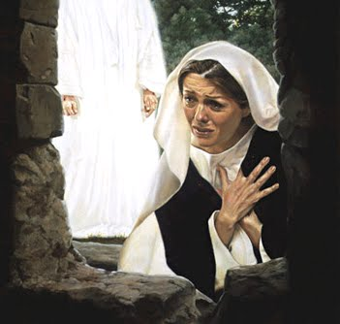
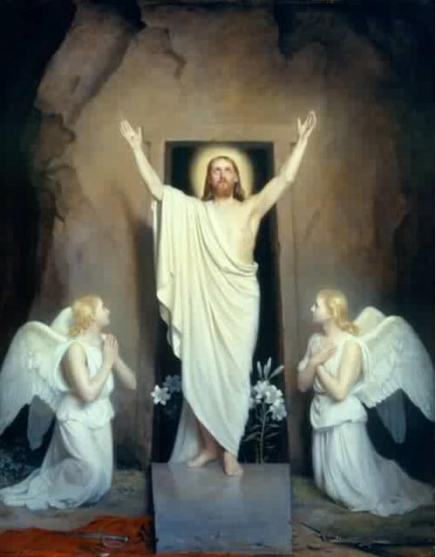
¹¹ Now Mary stood outside the tomb crying. As she wept, she bent over to look into the tomb ¹² and saw two angels in white, seated where Jesus’ body had been, one at the head and the other at the foot.
¹³ They asked her, “Woman, why are you crying?”
“They have taken my Lord away,” she said, “and I don’t know where they have put him.” ¹⁴ At this, she turned around and saw Jesus standing there, but she did not realize that it was Jesus.
¹⁵ He asked her, “Woman, why are you crying? Who is it you are looking for?”
Thinking he was the gardener, she said, “Sir, if you have carried him away, tell me where you have put him, and I will get him.”
¹⁶ Jesus said to her, “Mary.”

Slide 53
She turned toward him and cried out in Aramaic, “Rabboni!” (which means “Teacher”).
¹⁷ Jesus said, “Do not hold on to me, for I have not yet ascended to the Father. Go instead to my brothers and tell them, ‘I am ascending to my Father and your Father, to my God and your God.’”
¹⁸ Mary Magdalene went to the disciples with the news: “I have seen the Lord!” And she told them that he had said these things to her.

Slide 54
